Slide 1
Comprehensive Analysis of Gig Economy
GROUP: FEATURE ENGINEERS
CAPSTONE PROJECT
09/08/2025

Slide 2
Introduction
This project aims to analyze freelancing performance and earnings across various platforms and proffering insights and recommendations to help businesses, freelancers, and policymakers make informed decisions.
To achieve this goal, several factors that influenced freelancing performance were considered such as experience level, hourly rate, freelancing platforms, job categories and earnings etc.

Slide 3
Our rationale for the project includes:
Analyze freelancer job trends
Assess freelancer earnings
Identify key success factors
Develop interactive dashboards.
The key-variables analyzed include:
Total earnings
Client ratings
Average Rehire rate
Average Completion rate

Slide 4
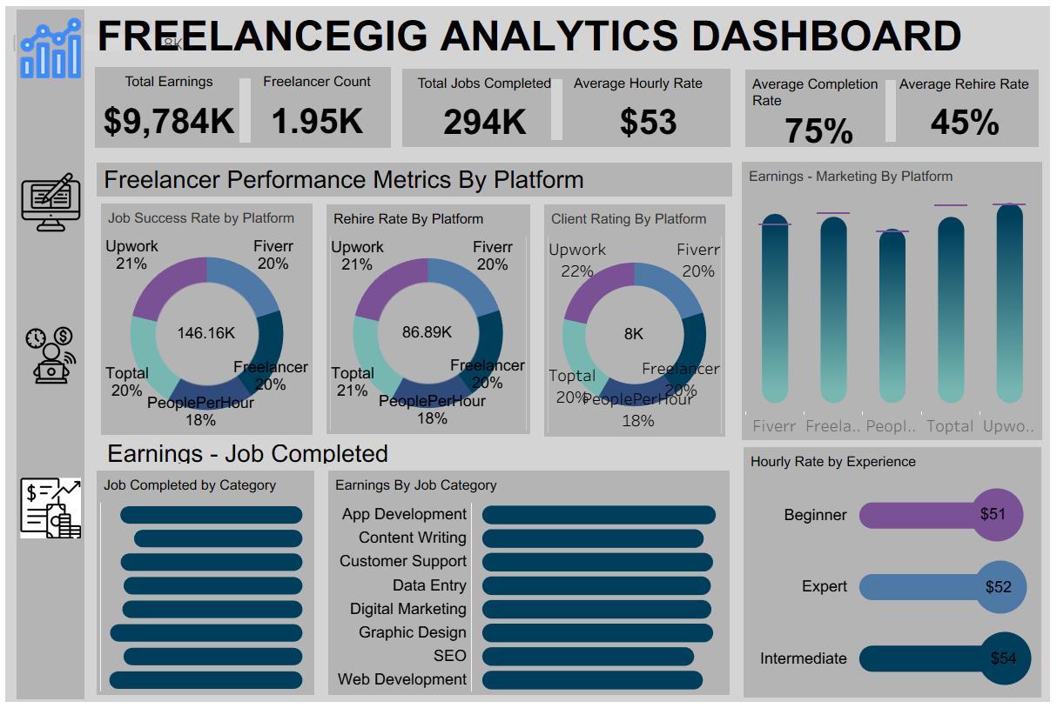
Dashboard

Slide 5

Data-driven Recommendations and Conclusion
1. Analysis shows that Graphic Design and App Development are the most profitable jobs.
Recommendation: New and aspiring freelancers should prioritize upskilling in Graphic Design or App Development for the best mix of income potential and job availability.
2. Analysis shows that different platforms favor different experience levels in terms of pay, hourly rate, and client retention.
Recommendation: Freelancers should choose platforms strategically based on their experience level. For instance:
Start on Toptal because of its strong rehire rate for beginners.
Grow on Upwork for its highest intermediate pay and job continuity.
Scale on Fiverr or PeoplePerHour for its top expert pay and hourly rates.

Slide 6
3. Analysis confirms that Upwork, Fiverr, and Freelancer.com offer the highest total earnings across freelancer types.
Recommendation: Freelancers seeking scalable income should aim to establish their presence on Upwork or Fiverr, as they have the highest earnings.
4. Analysis shows that Graphic Design and Web Development have the most completed jobs, helping freelancers build visibility and trust quickly.
Recommendation: Beginners in tech should start with in-demand categories like Web Dev or Graphic Design to build their portfolio and improve rehire chances.

Slide 7
Thank you.

